Slide 1
Portfolio
STUDENT PORTFOLIO

Slide 2
About me
Name: Ezhil.E
Course:Bsc.Computer Science
College Name: Valliammai Women’s College for Arts and Science
Email: ezhilezhumali2005@gmail.com
Phone no:8270976825

Slide 3
Table of the contents :
Self Introduction
Academic information Skills Projects Achievements Extracurricular activities Internship experience Personal details conclusion

Slide 4
Self introduction:
My self Ezhil Ezhumalai , studying second year computer science student with a passion for programming,webdevelopment,and problem solving.I believe in continuous learning and wish to contribute to the IT industry by creating efficient and user- friendly software applications.My career goal is to become a web developer and work on innovative technology projects

Slide 5
Accademic information:
Bsc Computer science: 2024-2027(Valliammai Women’s College for Arts and science)=80% Higher secondary:
2022-2024(Government Higher secondary school)=75% SSLC: 2021-2022(Government Higher secondary school)=89%

Slide 6
Skills:
Programming language-python,c++.
Web development-Html,Css,Javascript.
Ms office, photo Shop
Communication and presentation
Time management
Problem solving
Leadership and project management.

Slide 7
Achievement:
Received merit scholarship for scoring above 80% in all semester.

Slide 8
Extracurricular activities:
Creative pursuits –Arts, Music, writing quotes or other creative
activities.
Sports- Team sports and individual sports.
Singing

Slide 9
Personal details:
Date of birth:20/09/2005
Father name: Ezhumalai
Mother name : Punitha Ezhumalai
Address : 4/12, MARIYAMMAN KOVIL STREET, Amoor, Viluppuram, Tamil Nadu, 607209
Language known : Tamil, English
Hobbies and Interest : Reading novels,coding,
Singing,cooking..etc

Slide 10
Conclusion:
“I am an enthusiastic learner with strong technical and
communication skills. My future aspiration is to work in a reputed IT company as a software Engineer and later purse higher studies in Artificial intelligence. I am confident that my skills, projects,and dedication will help me achieve my goals.

Slide 11
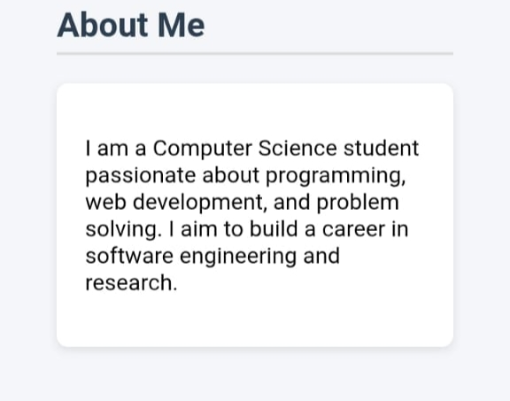
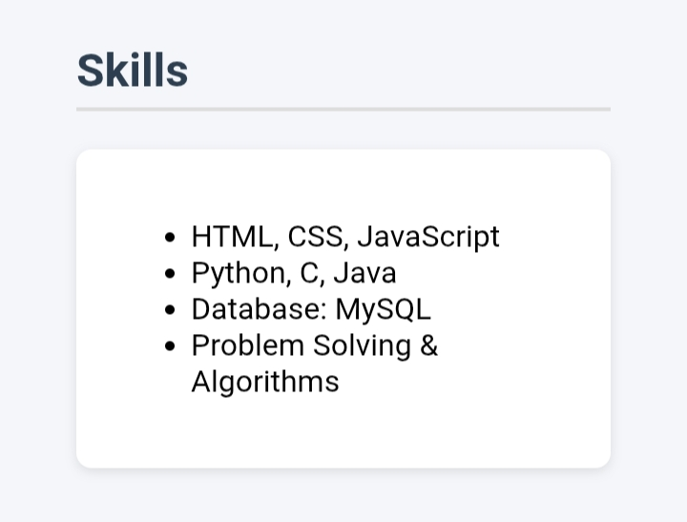
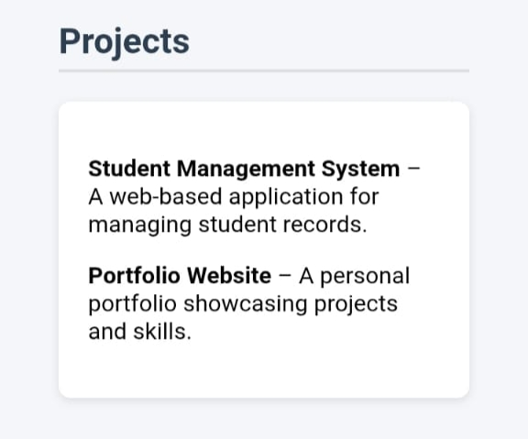
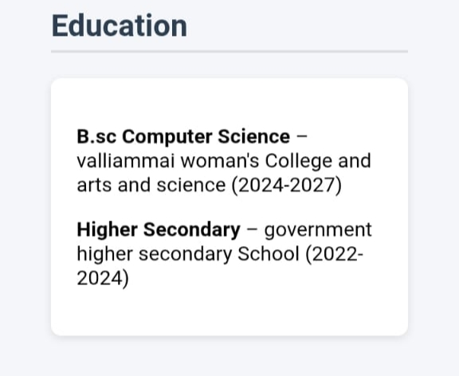

Slide 12
GitHub:
https://github.com/ezhilpunitha/HTML_BASIC_1ST_WEEK

